Slide 1

REAL CONSULTING
Sukanya Ahuja, Bhargav Ram Bindiganavile, Brian Inker, Nidhi Gadia & Justin Sohn

Slide 2





REAL Consulting Team
Sukanya Ahuja
Bhargav Ram Bindiganavile
Brian Inker
Nidhi Gadia
Justin Sohn
MSBA ’22,
Brandeis
University
MA ‘22, Brandeis University
BA ‘21, Brandeis University
MA ‘21, Brandeis University
BA ‘20, Brandeis University
MSBA ‘22,
Brandeis University
MA ‘22, Brandeis University
BA ‘21, Brandeis University

Slide 3
About REAL Consulting
Goal and Mission
Founded in 2021
Help individuals and business in making better, data driven, real estate investment decisions
Present our clients with the data they need to help them make smarter investments
Climate, crime, poverty, incomes, home prices, population…
Value Added
Help our clients meet their real estate investment requirements by sorting through data and preparing it in easy to digest ways.
Notes:
JUSTIN

Slide 4
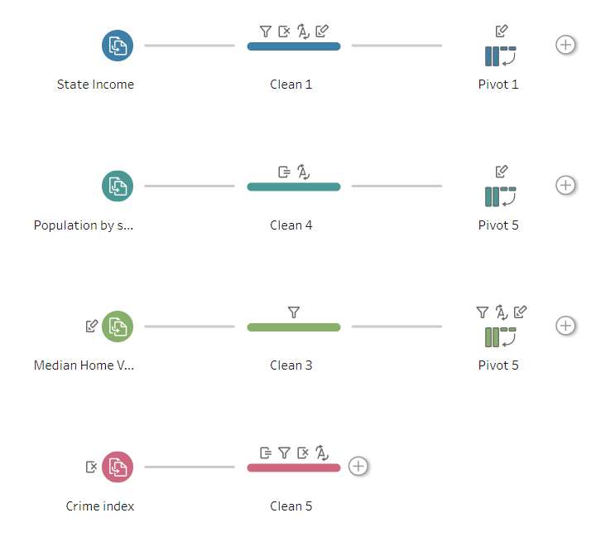
Our Data & Variables
Data Quality
Trusted and reliable sources only: CDC, FED, WHO, EPA, BLS…
Heavily cleaned: state names, US only, outliers, city level, years
Variables Analyzed
Poverty rates, Air quality, Sea levels, Health facts, Population factors, Income factors, Home values
Notes:
JUSTIN & maybe SUKANYA

Slide 5
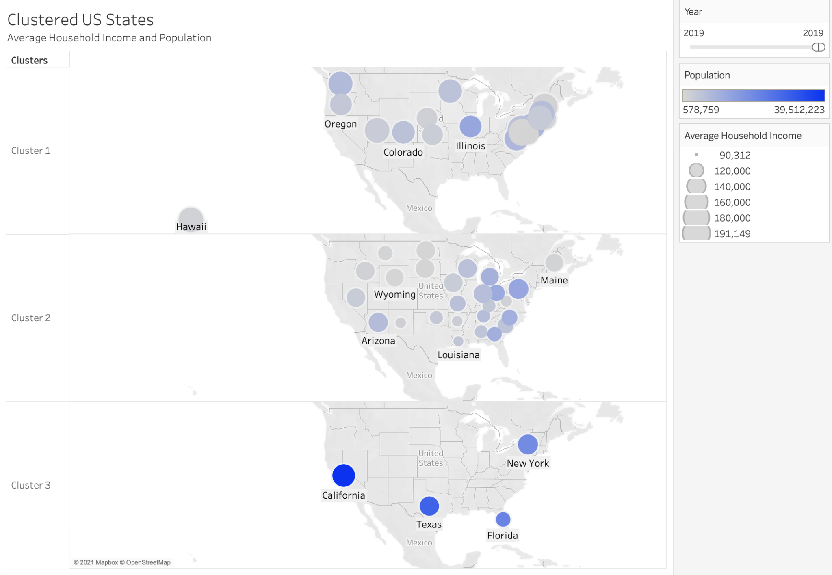
Visualizations & Interpretations
Cluster Analysis of US States by Population and Household Income
Clear visual of states with larger/smaller populations (color) and average household income (size).
Organized in clusters to easily focus on specific data values.
Notes:
JUSTIN

Slide 6
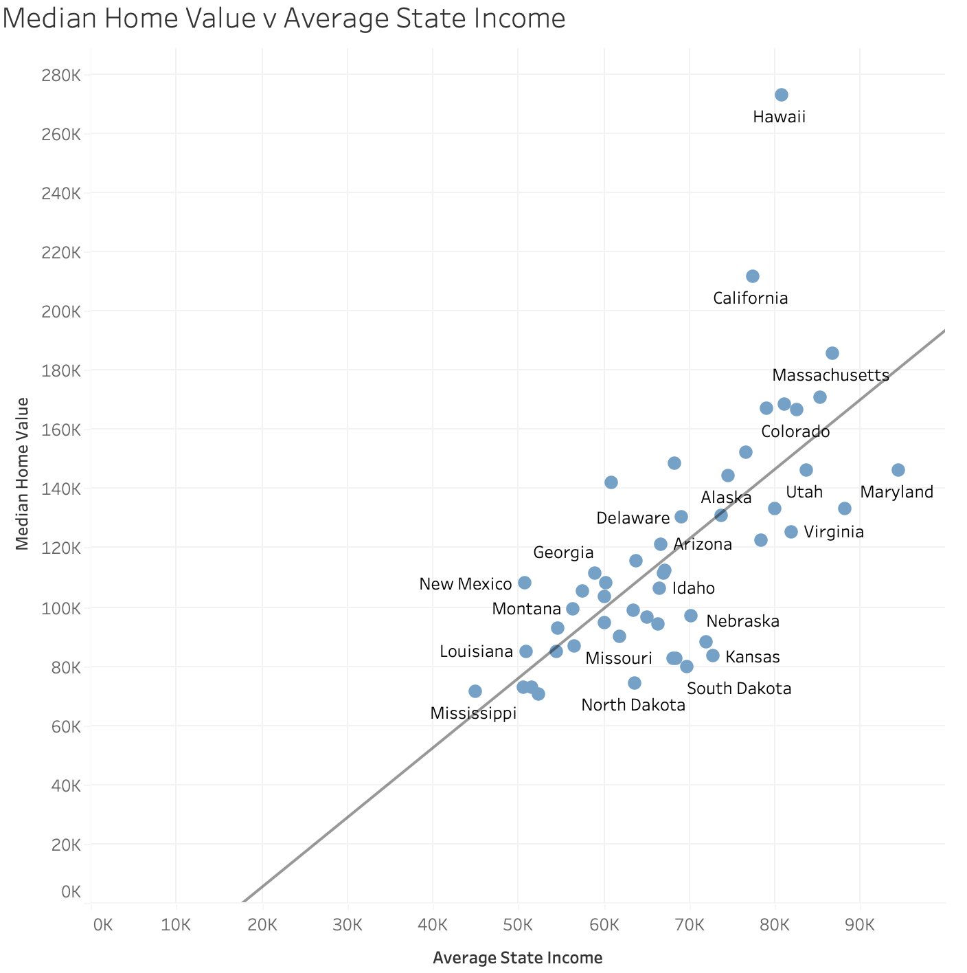
Visualizations & Interpretations
Scatterplot of Home Value and State Income
Easy to pinpoint states above or below the average in the United States and to find clear outliers amongst the data (Hawaii, California) that may present investment opportunities
Notes:
JUSTIN

Slide 7
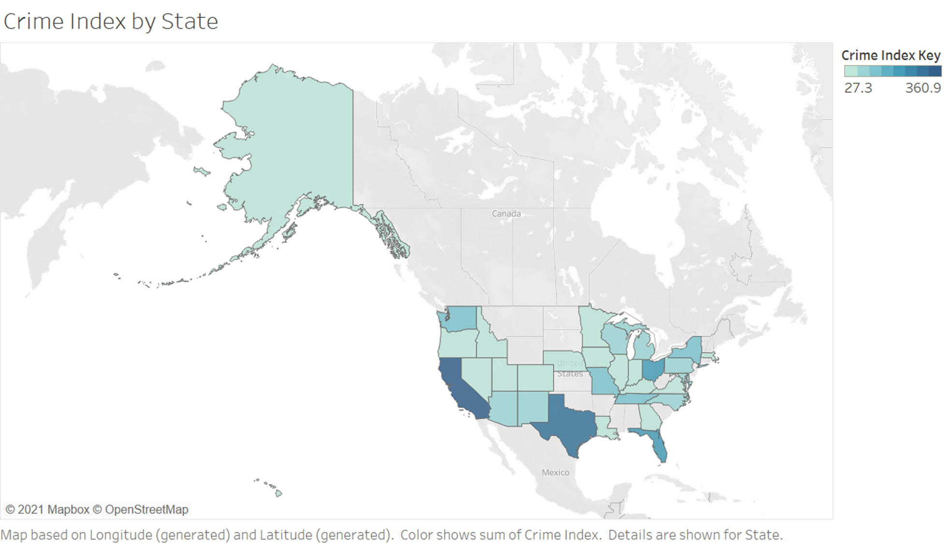
Visualizations & Interpretations
Heat Map of Crime Index by State
A simple way to understand what the crime statistics spread look like for the country.
The darker shades are a clear marker of widespread crime within the states. We see states like Texas, California, Florida and Ohio have high rates of crime.
This is an important metric for our consultancy as crime rates directly impact the price of real estate.
Notes:
Sukanya

Slide 8
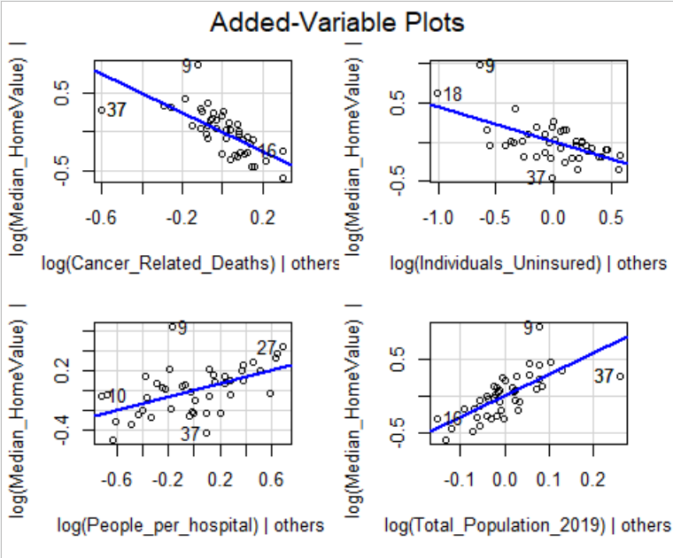
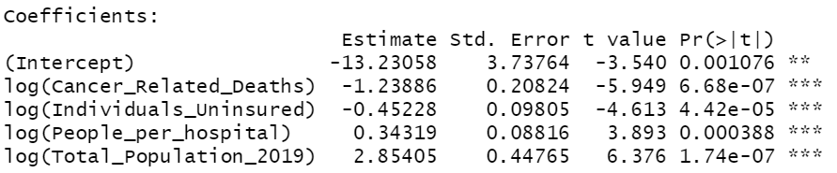
Visualizations & Interpretations
Regressing Median Home Value on various Health Statistics without the outliers
The data reflected the common economic intuition for the housing market.
Healthier populations, as seen in the plots with cancer mortalities and people per hospital, are associated with higher property valuations.
A large population in a given state is a marker for more expensive homes. This resembles the law of supply and demand.
Notes:
SUKANYA

Slide 9
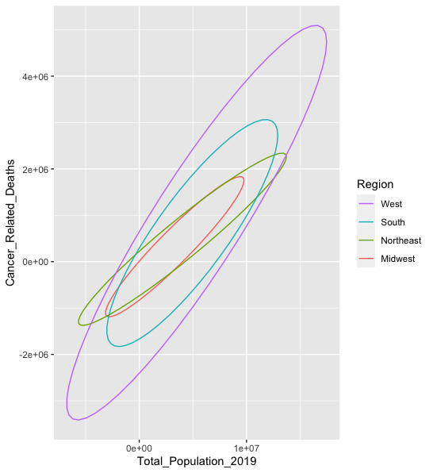
Visualizations & Interpretations
Ellipse Chart of Total Population and Cancer Mortalities by Region
Similar slopes show that as population increases, cancer mortalities increase
Northeast seems to less steep slope compared to other regions
Notes:
Ram

Slide 10
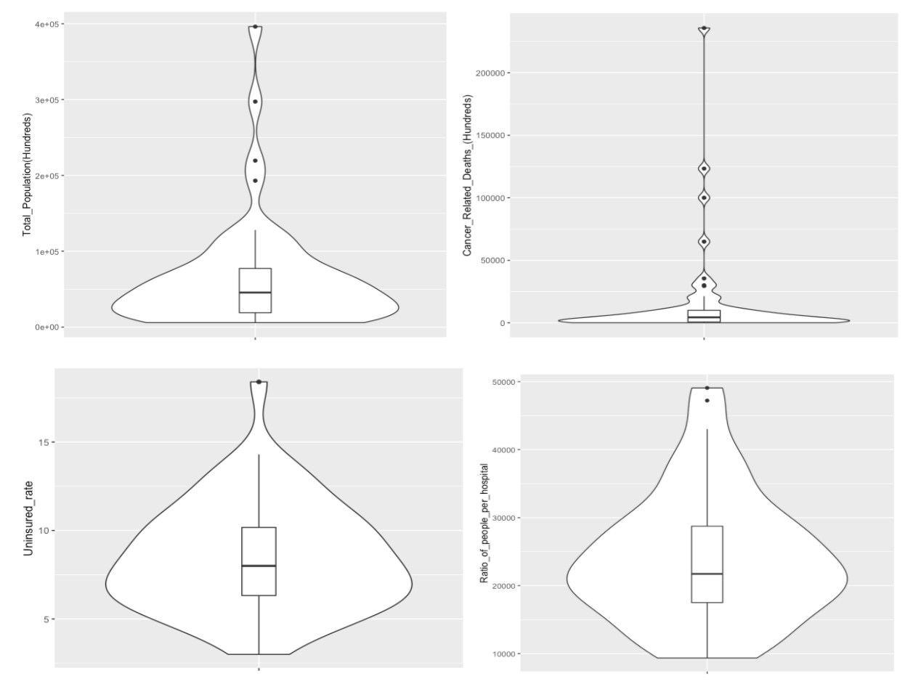
Visualizations & Interpretations
Violin Plots of Health Stats
Clearly depicts outliers in terms of population, cancer mortalities, uninsured rate, and people per hospital
Depicts spread and density of data (provides expectations)
Number of outliers for pop and cancer mortalities differ
Notes:
Ram

Slide 11
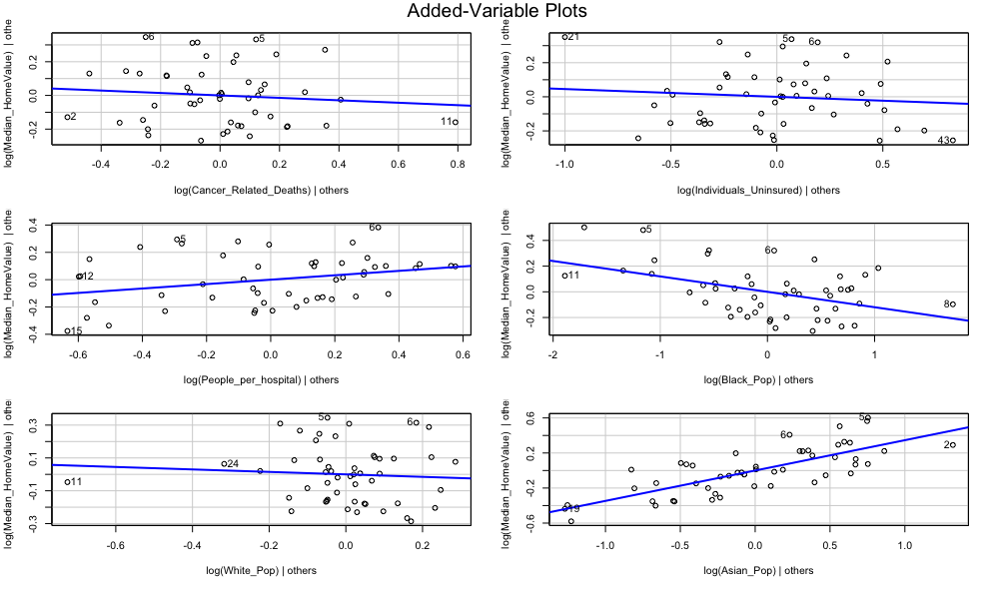
Visualizations & Interpretations
Multiple Regression of Median Home Values on Health Stats and Race Demographics
Association for cancer mortalities and uninsured population weakened
Value of home reduces as population of black individuals increases
Exact opposite for asian population
Notes:
Ram

Slide 12
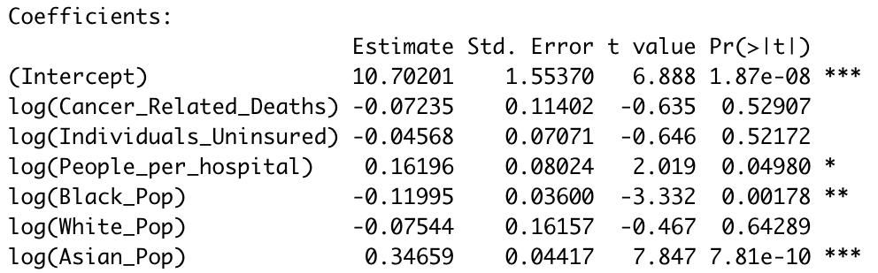
Visualizations & Interpretations
Multiple Regression of Median Home Values on Health Stats and Race Demographics
Significance of cancer mortalities and uninsured population variables weakened
Black_pop and Asian_pop explain target variable better than health stats
Notes:
Ram

Slide 13
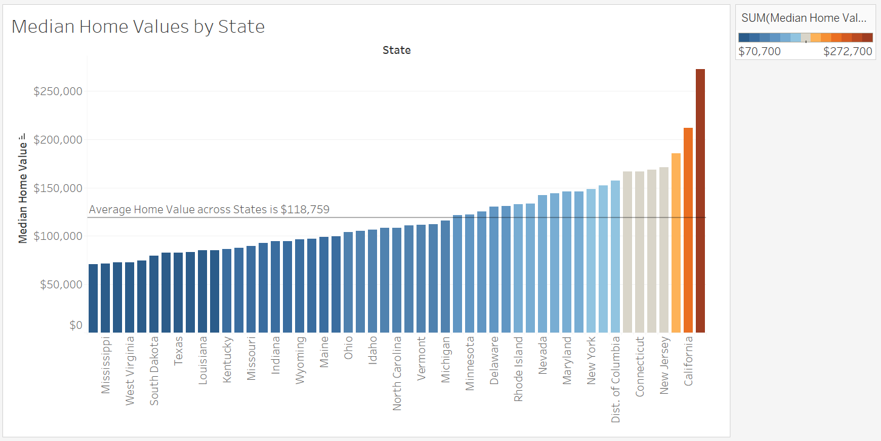
Visualizations & Interpretations
Bar Chart of Median Home Values by State
The color sorting makes it easy to identify the states with expensive homes
At the lower end, many states have similar prices while Connecticut, New Jersey & California are the most expensive with significant differences
Notes:
Nidhi
Thus, while making a real estate decision an individual can choose either of these states and can rather base the decision on factors other than price within these groups of states.

Slide 14
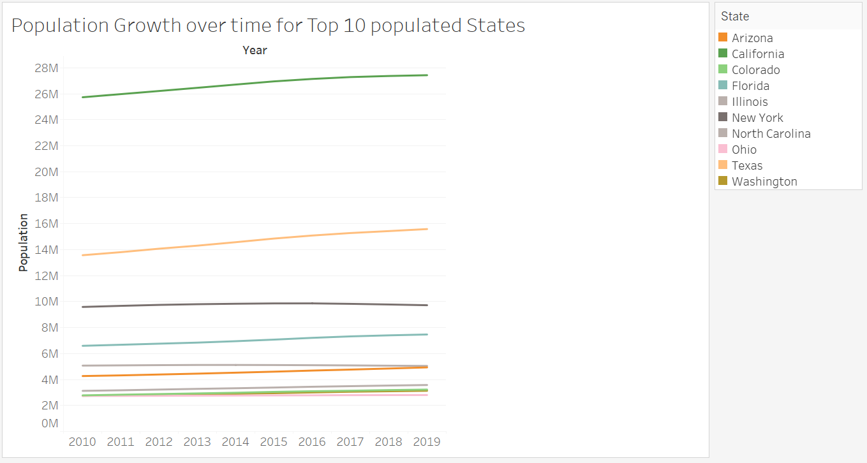
Visualizations & Interpretations
Line Chart of Population Growth over time for Top 10 populated states
May help us predict future population for a particular state
Important factor in real estate decision and affects the prices directly as well as the development of the state
Notes:
Nidhi
From the chart, it can be seen that Texas is growing at the fastest rate in terms of population followed by California. The population for the other states has remained more or less stable over time. This is shocking for a state like New York which is increasingly occupied by people looking for job opportunities from the USA & around the world.

Slide 15

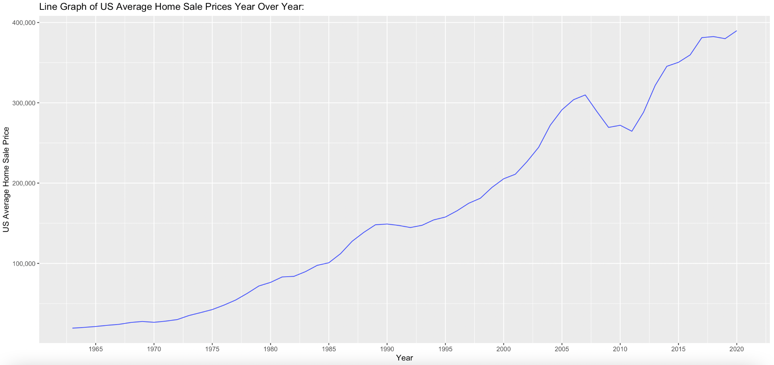
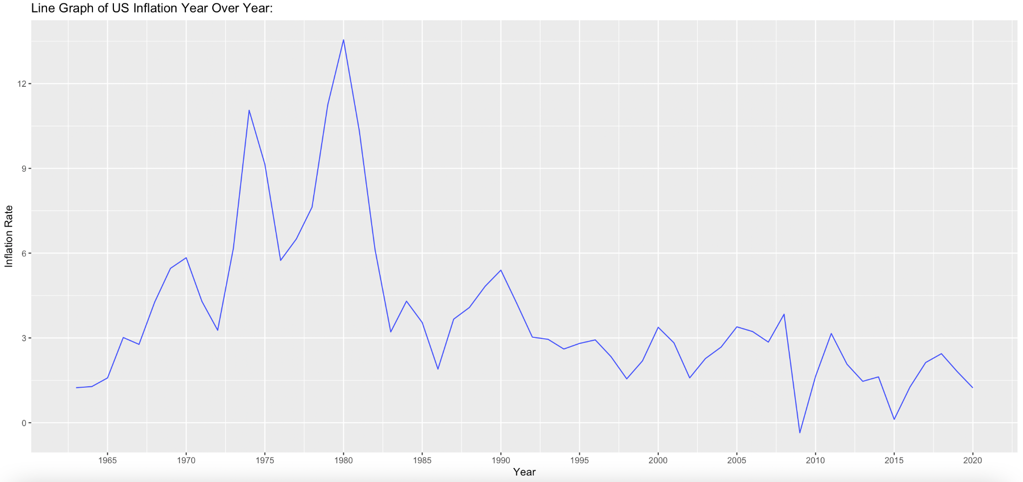
Visualizations & Interpretations
Line Graph of US Average Home Prices and Inflation Year over Year
Exponential growth of Home sales prices vs. decline of inflation since 1980
Definitively negative correlation between the two
Safe investment yet symptom of rising inequality
Notes:
Brian

Slide 16
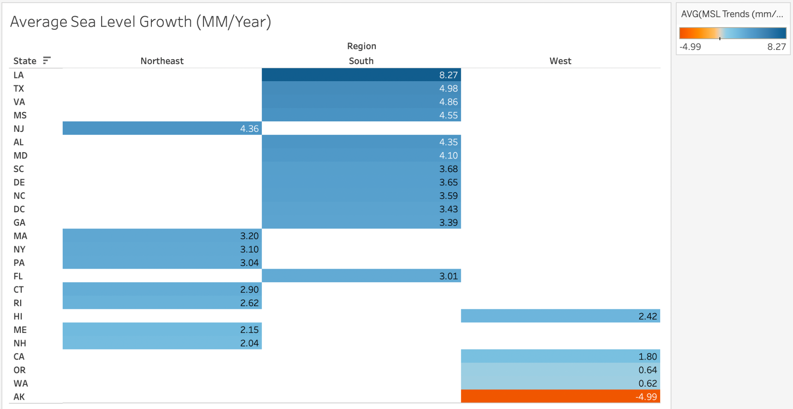
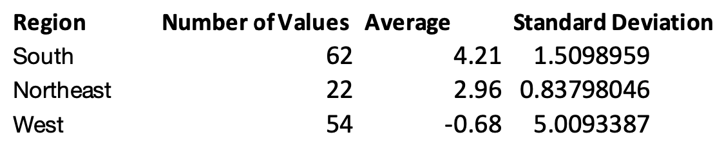
Visualizations & Interpretations
Highlight Table of US Regional and State Sea- Level Trends
The Southern US is at highest risk of dangerous rising sea levels
The Western US is lagging furthest behind at negative growth but has highest volatility
Notes:
Brian

Slide 17

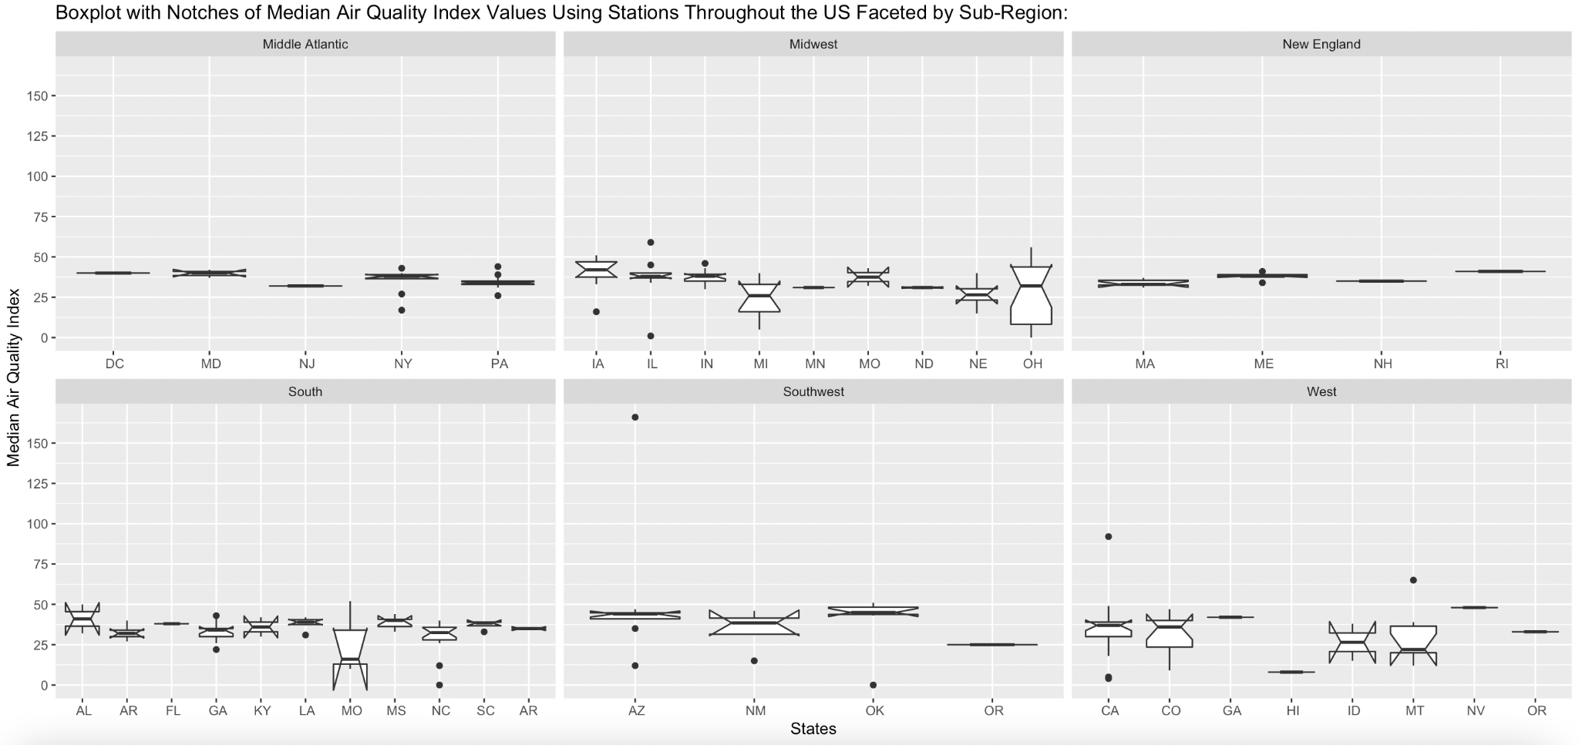
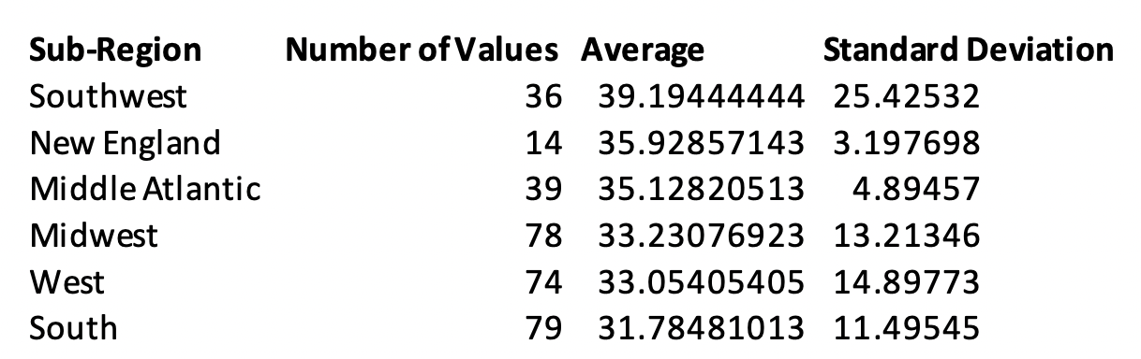
Visualizations & Interpretations
Boxplot with Notches of States’ Median AQI Values Faceted by US Sub-Region
Southwest has highest average AQI and highest volatility with South having lowest average AQI and moderate volatility
New England and Middle Atlantic have middle of the pack average AQI and much lower volatility, potentially due to increased homogeneity
Notes:
Brian

Slide 18
Reflections
Data Analysis Conclusions
There is no limit to what we can add
Some surprises
Asian population association with median home value
States with higher than average state income anchored by a major US city (Chicago, IL)
Air quality is the worst in the southwest
NY population almost constant from 2010 to 2019
So many different factors can alter real estate investment decisions

Slide 19
Reflections
Journey with the Data
Good data is important
Clean, clean, clean
Coherence in data - Timeframes, state v city…
Collaborative work is important

Slide 20
Thank you! Questions?

Slide 21
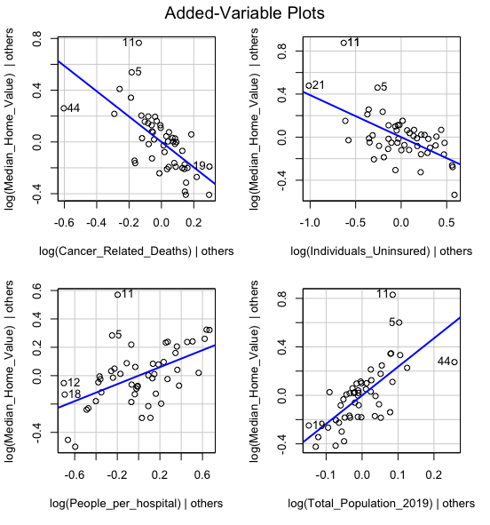
Visualizations & Interpretations
Multiple Regression of Median Home Values on different Health Stats
Healthier environments are more expensive to live in
Individuals who can afford health insurance populate regions with higher priced homes
Homes tend to be more expensive in areas more populated
Notes:
Ram

